Slide 1
Next Generation Payment
BY : Rishabh Singhal
Arpit Raj

Slide 2
---
Are you too a victim of card fraud or think that carrying cards for payment is a kind of headache.

Slide 3

We came up with a solution which provides best secure payment method and is very fast and handy to use.

Slide 4
Index :
Using ‘One Click Payment’ on ATM and POS
Using ‘One Click Payment’ for Online Payment
Advantages over current Payment methods

Slide 5

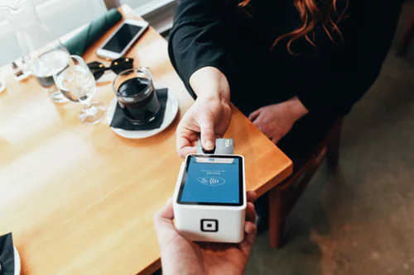
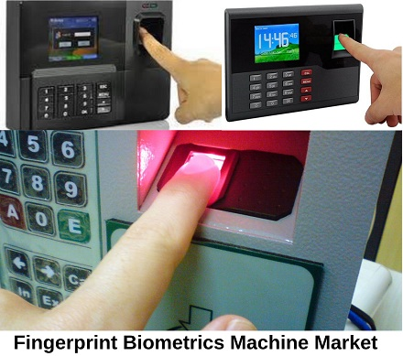
Step1 : Place your verified finger on the
fingerprint scanner available on the device.
POS
ATM

Slide 6
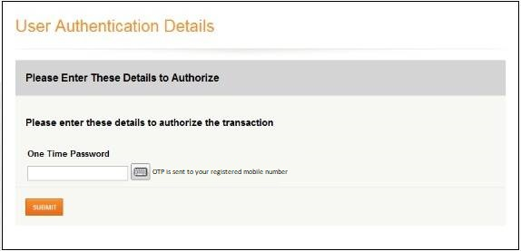
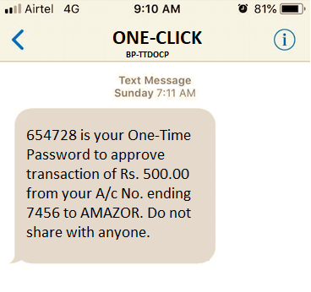
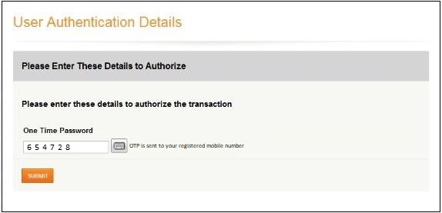
Step2 : Enter OTP received on your registered mobile number

Slide 7
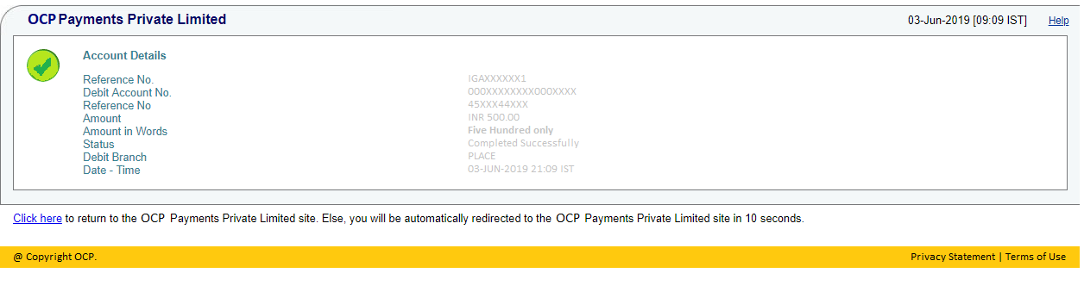
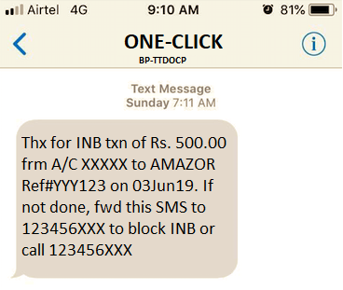

Slide 8
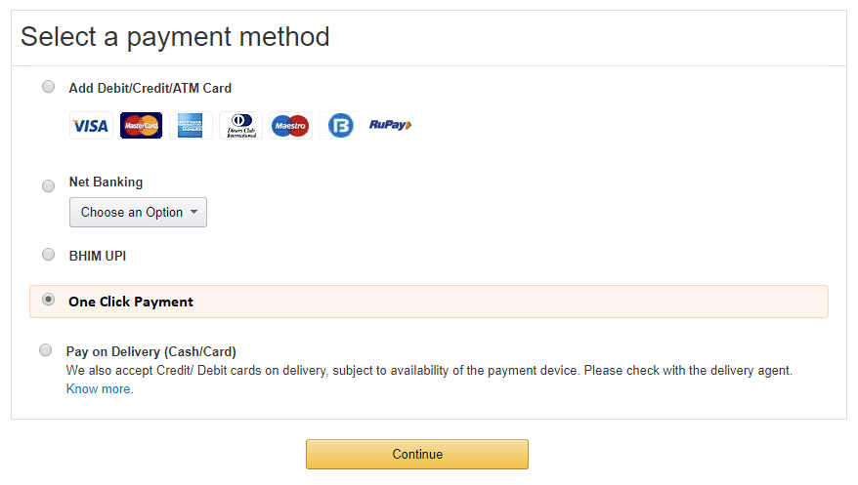
Step 1 : At Select Payment Mode, a new option will be shown - One Click Payment. Select and click on continue.

Slide 9

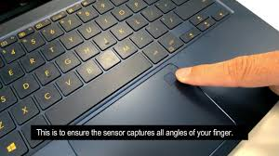
Step2 : Place your verified finger on the
fingerprint scanner available on your device.

Slide 10
Step3 : Enter OTP received on your registered mobile number

Slide 12

But how do I register for this site
I know how to use this
Payment processing:

Slide 13
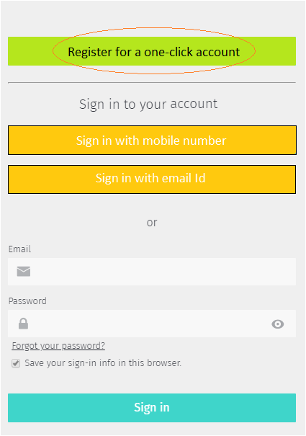
Steps to Register on a One-Click Account
Open the website. Click on register for a one-click account.
Next, fill the personal details along with the mobile number which is linked to your Bank Accounts.

Slide 14
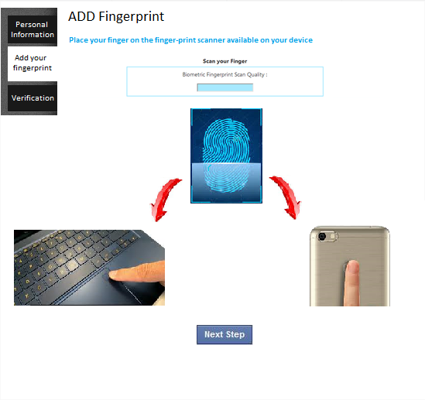
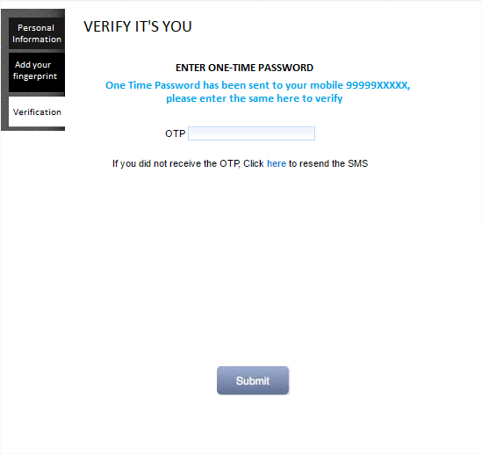

Slide 15
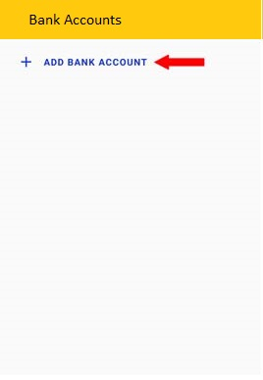
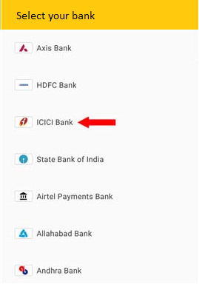
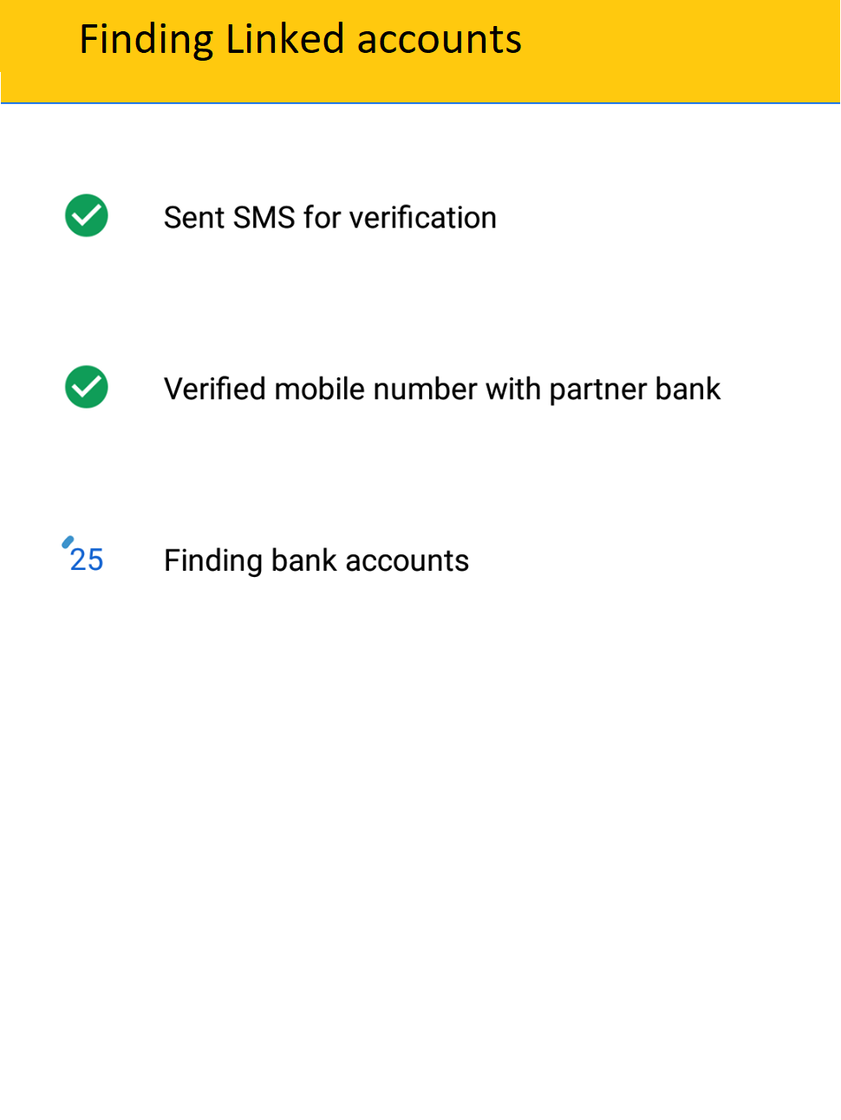
Steps to add bank accounts:

Slide 16

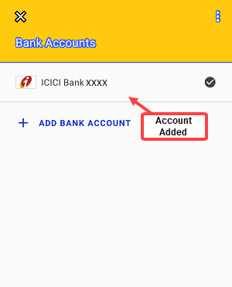
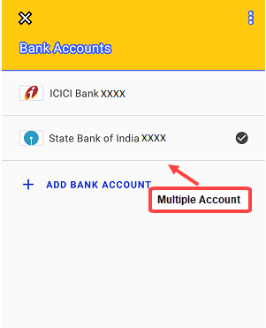

Slide 17
Other Key features:
POS and ATM devices will have an additional feature of FingerPrint Scanner to provide cardless payment .
Completion of payment with OTP is one of the most secure method .
Our finger will be linked to the registered account.
One option i.e. One Click Payment will be provided at Select Payment Mode at the online shopping sites.
To use this service, User has to validate his Aadhar/PAN card details.
We will provide default Bank option from which the payment will be deducted .
Users will be provided with an option to Change-your-default-Bank.
User will put their linked Finger on fingerprint-scanner available on the device after which one OTP will be received on the registered mobile number using which final payment can be processed.
More than one finger can be linked to the account, even after registration.

Slide 18

Use one click payment it helps in keeping all the bank account at one place and U can also select default bank option and even use this at withdrawing cash at ATM
I have so many bank accounts and now I am facing trouble in managing them.

Slide 19
Advantages over available payment services :
This approach can be used in messaging apps.
All of Users Bank Account (Paytm Payment Bank/Sbi/Hdfc/Airtel payment bank,etc) can be found at a single place which will help in proper Management .
More than one fingerprint option will be available so we can add our relatives finger if we want.
Since all of new mobile phones and laptops avails fingerprint scan option which makes this method very easy to implement.
This payment approach will help in minimising card frauds.
This method is fast , easy to use and more secure.

Slide 20


Oh!! I forgot my wallet at home
Who needs it anyway
Note
In future, Eye scanning payment option may also be used, specifically for handicaps.

Slide 21


